Slide 1
Discovering your Discovery System in Real-Time
Annette Bailey
Godmar Back

Slide 2
(Academic) Libraries in 2014: some observations
Majority of library resources used are electronic
Physical space is being dedicated to student work areas and digital displays
Librarians are becoming active partners in all stages of research
Libraries are replacing their OPACs with discovery systems
Notes:
History of Summon at Virginia Tech
Customer since 2010
Used Summon to change workflows
All electronic resources are in Summon
No longer using ILS for public access to eresources
Summon changes every 3 weeks, sometimes drastically
Summon Assessment Team led by head of Research and Instruction Services department
VT has not switched to Summon 2.0, yet

Slide 3
Risks associated with these changes
Use of library collections becomes invisible
Search engines compete with discovery systems for users requiring substantial marketing effort for the discovery system
Challenge:
Make the discovery process & use of resources visible!

Slide 4
Can We See What Our Users are Doing?
There’s the COUNTER standard which gives us usage data
Usually, after the fact, and (somewhat) hard to process
Topic of a different talk/project …
Summon provides analytics data on search terms & click data
Aggregate, not real-time
Google Analytics can record data
But no real-time access
But what if we could see what our users are doing in real time (while still affording them some privacy)?
And what if we could share that with other members of the community?

Slide 5
Discovering Discovery
Visualize, in real-time, the items users discover as they click on results in Summon
It’s as if we could see what object the user is plucking off the shelf. We can’t see if they actually use the object, but we know that they are interested enough to go further than the search results.

Slide 6
Live Demos
Let’s see what users are clicking on in the VT instance of Summon right now!
Twitter-Style Widget: [Link]
Summon Cube [Link]
Word Cloud (Subject/Last50) (Title/Last50)
Gauge [Link]
Discipline Ticker: [Link]
Publication Year Chart [Link]

Slide 7
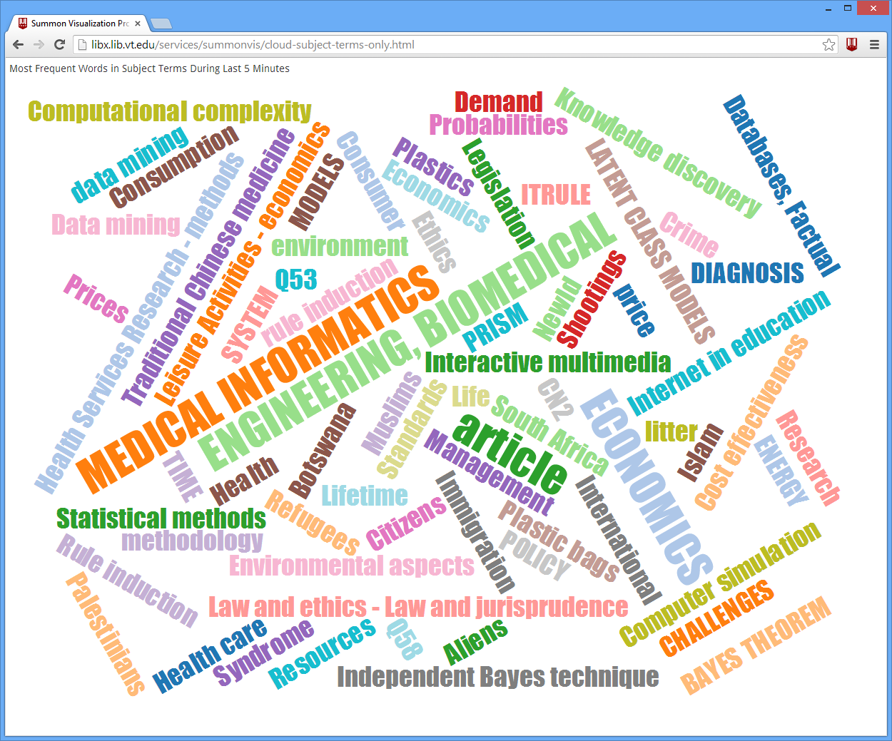
Notes:
Note – roughly even distribution.
Not cleaned up (see ‘data mining’ and ‘Data mining’
But since it’s taking subject terms literally, preserves compound nouns such as ‘medical informatics’
Backup Slide

Slide 8

Summon Cube

Slide 9
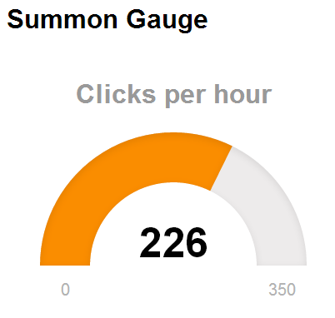
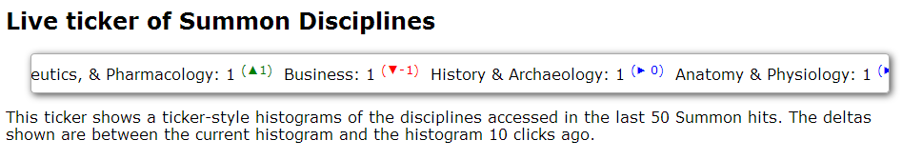
Ticker & Gauge

Slide 10
Impact
Our research community is not just using Google, they are using Summon and it is clear from the searches and results that they are clicking on, they are using Summon for research.
This project allows not just librarians, but the community (and potential members of the community – potential students) to see what research is happening at Virginia Tech – in real time.
Intended both as webservice/widget, or as public display in the library
Notes:
Make joke about not having media-tiled space like NCSU.

Slide 11

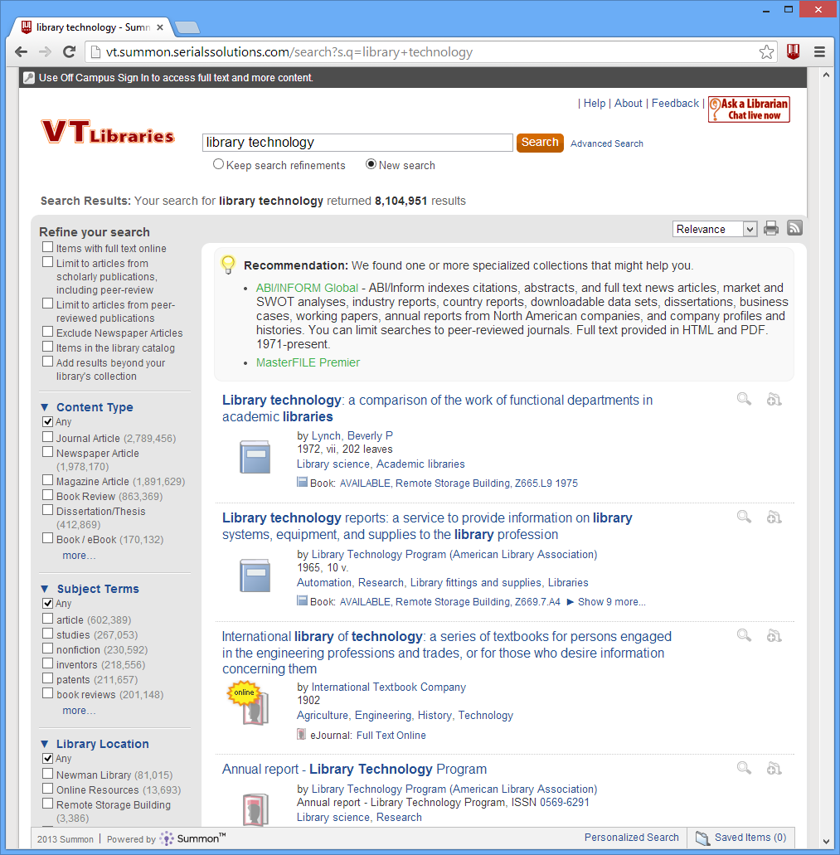

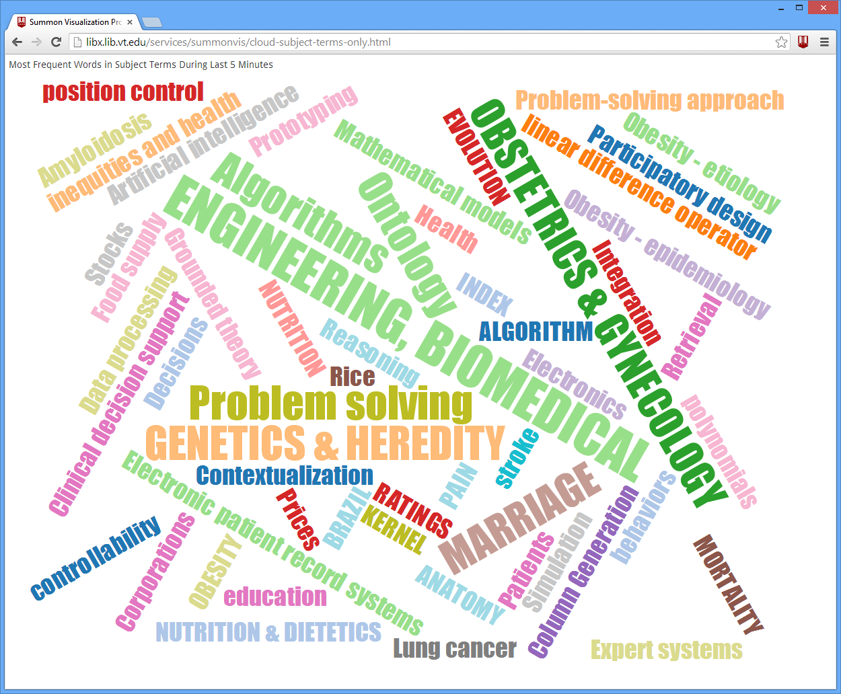

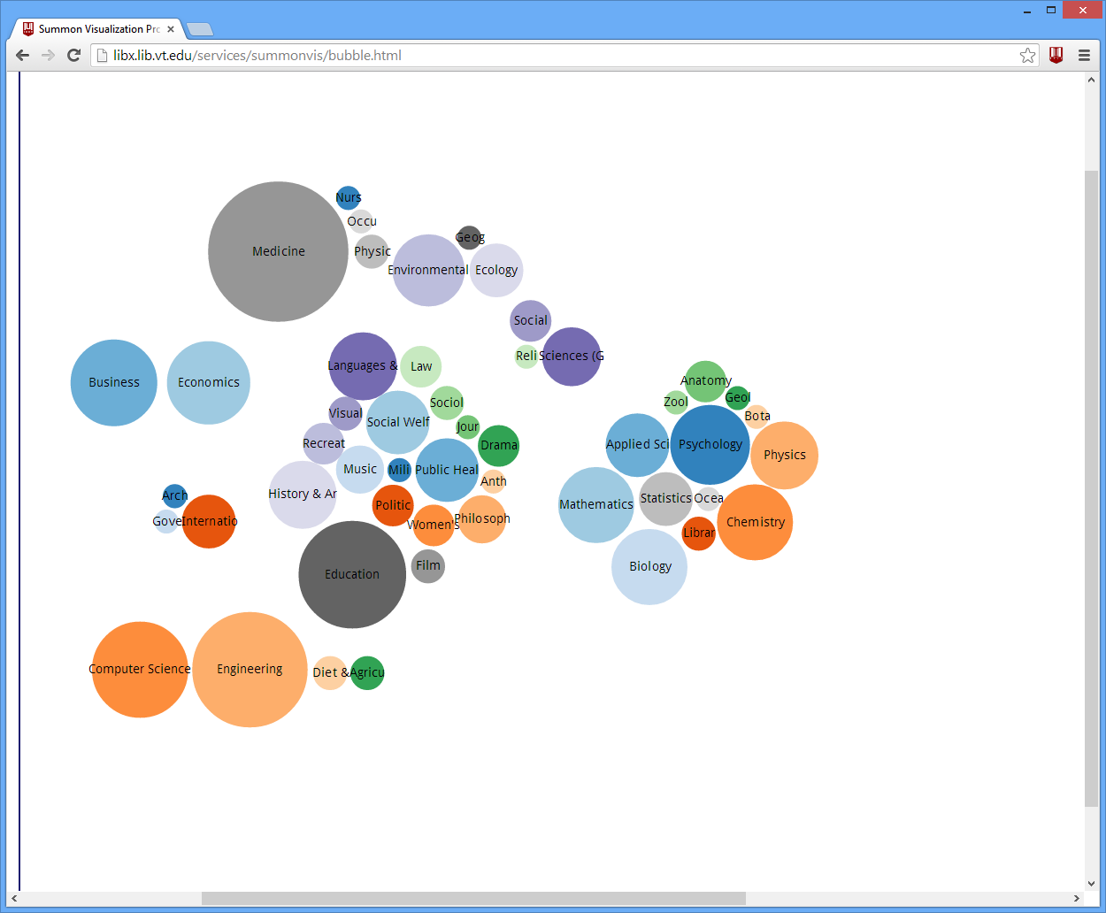
Summon Web Interface
D3-based visualizations
Searches
Custom JS
Record Click
Visualization Server
e.g. libx.lib.vt.edu
DB
Get Record
Summon API 2.0
Notes:
We run the visualization server right now – a simple Unix box that runs Apache, node.js, a Python program in the background.

Slide 12
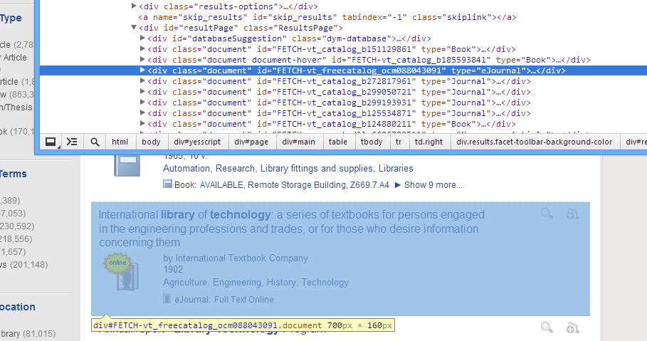
Technical Details: Click Recording
Summon embeds the Summon ID of each result in the page
Notes:
When analyzing Summon page with Chrome’s inspector, we find that the record id is stored as an attribute ‘id’ in the div surrounding the display.

Slide 13
Technical Details: Click Recording
$(function () {
$('#resultPage .document').each(function (idx, doc) {
var $doc = $(doc);
var id = $doc.attr('id'); // extract id
function recordClick() {
var cImg = new Image(1, 1); // create unique URL to avoid browser cache
cImg.src = “http://libx.lib.vt.edu/services/summonvis/click.gif?"
+ "id=" + encodeURIComponent(id)
+ "&_ts=" + Math.floor(Math.random() * 10000000);
}
// register click handler for the multiple links a user may use
$doc.find("a.documentLink").click(recordClick);
$doc.find("div.previewDocumentTitle a").click(recordClick);
$doc.find("div.thumbnail a").click(recordClick);
$doc.find("div.Availability div.summary a").click(recordClick); });
});
Notes:
This JavaScript finds each displayed record (‘document’).
It find four links embedded in it and attached the ‘recordClick’ handler.
There, it constructs an ‘image’ – this causes the browser to contact the libx.lib.vt.edu URL, in the process sending the ID in the query string part of the URL.
The image itself is a tiny 1x1 gif image. (This is how webbugs work that check if you’ve read an email)

Slide 14
Technical Details: Logging Clicks
Use Apache Common Log Format (no recording of referrer URL)
xxx.82.xxx.75 - - [07/Nov/2013:16:20:28 -0500] "GET /services/summonvis/click.gif?id=FETCH-webofscience_primary_0002758417006911&_ts=390057 HTTP/1.1" 200 333
xxx.82.xxx.92 - - [07/Nov/2013:16:21:27 -0500] "GET /services/summonvis/click.gif?id=FETCH-vt_catalog_b223625751&_ts=6148119 HTTP/1.1" 200 333
xxx.82.xxx.11 - - [07/Nov/2013:16:21:27 -0500] "GET /services/summonvis/click.gif?id=FETCH-proquest_abstracts_14361167591&_ts=1597476 HTTP/1.1" 200 333
# Excerpt from Apache config file: /etc/apache2/sites-enabled/000-default
# do not log user's query terms
SetEnvIf Request_URI "^/services/summonvis" dontlog
# log resource ids users actually click on
SetEnvIf Request_URI "/services/summonvis/click.gif" clicklog
CustomLog /var/log/apache2/access.log combined env=!dontlog
CustomLog /var/log/apache2/click.log common env=clicklog
Notes:
We configured Apache to log those clicks.
The top shows the log entries (the IP address partially obfuscated)
The bottom shows how you configure this in Apache’s config file if anyone cares.

Slide 15
Some Statistics
Notes:
A counted the log entries. January was partial, as is November.
Can see the Summer break.
Is Summon use increasing this semester? It looks this way (Oct equal Mar)
Note that items are clicked on multiple times (530,000 vs. 344,000)

Slide 16
Log Tracing
When a click entry is added, we must contact Summon API right away
Summon IDs are very short-lived due to constant record update & merging
Summon API
Supports querying in the same manner as Summon web front-end
Supports additional query-styles, such as retrieve by ID
Requires API-Key (which must be safe-guarded)
Returns JSON or XML
SQLite
We store all records in SQLite DB
See http://www.sqlite.org/
import sqlite3
conn = sqlite3.connect(dbfilename)
conn.execute('''CREATE TABLE IF NOT EXISTS summonrecords
(id TEXT PRIMARY KEY, recordjson TEXT)
''')
Notes:
Keypoints: Summon API key cannot be leaked.
We use SQLite3, which is a transactional SQL database.
SQLite is a software library that implements a self-contained, serverless, zero-configuration, transactionalSQL database engine. SQLite is the most widely deployed SQL database engine in the world. The source code for SQLite is in the public domain.
Note: the table (SQL shown here) – is dead-simple. Maps record id to JSON record. Nothing else. Just 1 table.
Storing the 345,000 records required about 2.6GB of space.
We do not currently index this DB on anything else (but that would be necessary for other, real-time analyses, perhaps.)
Python code shows how to access the SQLite DB from Python

Slide 17
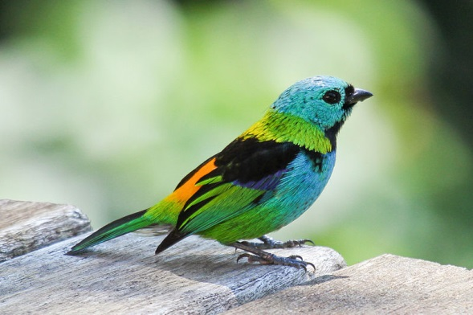
Sample Record
{
"Author": [
"Zdziarski, JM",
"Little, SE",
"Adkesson, MJ"
],
"ContentType": [
"Journal Article"
],
"DOI": [
"10.1605/01.301-0000384790.2006"
],
"DatabaseTitle": [
"ProQuest Illustrata: Natural Sciences",
"ProQuest Deep Indexing: Biological Science"
],
"Discipline": [
"Veterinary Medicine"
],
"EISSN": [
"1937-2825"
],
"SubjectTerms": [
"Cyanerpes caeruleus",
"Cyanerpes cyaneus",
"Tanager whole blood",
"Polymerase chain reaction results",
"Dacnis cayana",
"Tissue samples"
],
"Title": [
"Atoxoplasmosis In Tanagers"
],
"PublicationYear": [
"2005"
],
"SourceType": [
"Index Database"
],
"StartPage": [
"265"
],
"EndPage": [
"272"
],
"ISSN": [
"1042-7260"
],
"IsPeerReviewed": [
"true"
],
"IsScholarly": [
"true"
],
"Issue": [
"2"
],
"Language": [
"English"
],
…
}
Selected fields from JSON response
http://en.wikipedia.org/wiki/Tanager
Notes:
This is not all fields, just to give an intuition.
What’s a tanager? That’s one.

Slide 18
Sample Record (2)
{
"Abstract": [
"Introduction. To report a live birth following egg retrieval after only 12 hours from hCG priming. Patients. A childless couple with five-years-lasting secondary infertility. Methods. IVF was performed according to the long protocol. Two immature oocytes were retrieved following only 12 hours after hCG priming due to the patient misunderstanding. The eggs were cultured in vitro and ICSI was performed following polar body extruded after 24 hours in culture. After additional 24 hours a 4-cell embryo was developed and ET was performed. Results. A viable pregnancy was achieved and a healthy baby girl was delivered at 38 weeks of gestation. Conclusion. In a rare and unexpected situation when immature oocytes are retrieved following a short hCG priming, the eggs should be cultured in vitro, late ICSI should be performed, and a pregnancy may be expected."
],
"Snippet": [
"\u00a0 Introduction. To report a live birth following egg retrieval after only 12 hours from hCG priming. Patients. A childless couple with five-years-lasting...",
"Introduction. To report a live birth following egg retrieval after only 12 hours from hCG priming. Patients. A childless couple with five-years-lasting..."
],
"Title": [
"A Live Birth Subsequent to IVF following Egg Retrieval Only 12 Hours after hCG Priming"
],
"URI": [
"http://dx.doi.org/10.1155/2013/634385",
"http://search.proquest.com/docview/1428017900",
"http://www.ncbi.nlm.nih.gov/pubmed/23762684"
],
Selected fields from JSON response
Notes:
Some journal article records have abstracts and snippets. These can be used to extract keywords, etc., but unlike for Subject Terms, we will have to reconstruct compound nouns (e.g., baby girl), which we’ll plan to do using the n-gram method.

Slide 19
Current Log Analysis
Extracts & tabulates easy-to-analyze variables
over time periods: 1 min, 5 min, 1 hours, 1 day, 1 week
over counts: last 50, last 100, last 200, last 1000, last 10000
Tabulates frequency by categories such as
Discipline
ContentType
SourceType (of record)
PublicationYear
Tabulates word frequencies for
Abstract, Title, Abstract & Title together (individual words)
Keywords, Subject Terms, Keywords & Subject Terms together (preserving compounds)
Notes:
(This is read from the Python code, and it’s all a bit ad hoc. More experimentation is needed I haven’t had time to do.)
Note that this tabulating is done on-the-fly. As the user clicks, an entry is added to the click log, the log watcher wakes up and retrieves the ID from the click.log. It then checks the database, if the record was clicked on before, it’s gotten from there. Else we go to the Summon API. Then we process the record and update our tabulators. The current results of all tabulators are written to 30 directories: http://libx.lib.vt.edu/services/summonvis/livesummaries/
The most recent is in http://libx.lib.vt.edu/services/summonvis/livesummaries/now/

Slide 20
Example 1: Tabulating Disciplines
{ Discipline:
{ Psychology: 4,
'Applied Sciences': 1,
'Public Health': 1,
Forestry: 1,
Religion: 6,
'Environmental
Sciences': 4,
Music: 2,
Medicine: 7,
Mathematics: 2,
'Sciences (General)': 2,
Biology: 5,
Business: 1,
Government: 2,
Philosophy: 6,
Anthropology: 1,
'Computer Science': 3,
'Sociology & Social History': 2,
Law: 5,
'Languages & Literatures': 6,
'International Relations': 1,
'Library & Information Science': 1,
Economics: 4,
Physics: 4,
'Visual Arts': 1,
Ecology: 3,
'History & Archaeology': 1,
Geology: 2,
'Anatomy & Physiology': 1,
Engineering: 7,
Zoology: 1,
Education: 5,
Agriculture: 6,
Film: 1,
Geography: 1 },
timestamp: '2013-11-07T19:07:00-05:00' }
Last 1 hour
Notes:
This is from http://libx.lib.vt.edu/services/summonvis/livesummaries/now/Discipline.3600 as of Thursday 7:08pm.
Tabulators remove entries on each click processing. So for instance, if the ‘Forestry’ record was more than 1 hour ago, the tabulated count of ‘Forestry’ goes to ZERO.
(Side note, as we discussed, this has the effect that entries stay until the next click, even if more than 1 hour has passed.)

Slide 21
Example 2: Tabulating PubYear
'1960': 3,
'1961': 9,
'1962': 5,
'1963': 1,
'1964': 5,
'1965': 9,
'1966': 9,
'1967': 8,
'1968': 3,
'1969': 13,
'1970': 10,
'1971': 5,
'1972': 8,
'1973': 2,
'1974': 16,
'1975': 6,
'1976': 5,
'1977': 8,
'1978': 4,
'1979': 8,
'1980': 9,
'1981': 7,
'1982': 10,
'1983': 12,
'1984': 10,
'1985': 16,
'1985': 16,
'1986': 19,
'1987': 16,
'1988': 12,
'1989': 21,
{ timestamp: '2013-11-07T19:11:24-05:00',
PublicationYear:
{ '1765': 1,
'1775': 1,
'1790': 1,
'1791': 1,
'1793': 2,
'1850': 1,
'1855': 1,
'1863': 1,
'1871': 1,
'1876': 1,
'1879': 1,
'1880': 1,
'1881': 1,
'1882': 1,
'1889': 1,
'1895': 2,
'1899': 3,
'1900': 1,
'1901': 4,
'1902': 1,
'1903': 1,
'1905': 1,
'1913': 1,
'1915': 1,
'1990': 29,
'1991': 16,
'1992': 32,
'1993': 29,
'1994': 29,
'1995': 34,
'1996': 43,
'1997': 33,
'1998': 62,
'1999': 58,
'2000': 56,
'2001': 85,
'2002': 72,
'2003': 70,
'2004': 106,
'2005': 100,
'2006': 104,
'2007': 103,
'2008': 149,
'2009': 177,
'2010': 222,
'2011': 251,
'2012': 323,
'2013': 281,
'2014': 1 } }
'1916': 2,
'1920': 3,
'1923': 1,
'1924': 1,
'1925': 1,
'1926': 2,
'1930': 2,
'1931': 2,
'1932': 2,
'1933': 1,
'1934': 1,
'1936': 3,
'1938': 1,
'1941': 2,
'1942': 2,
'1946': 1,
'1947': 1,
'1948': 2,
'1951': 1,
'1952': 1,
'1954': 3,
'1955': 3,
'1956': 2,
'1957': 4,
'1958': 7,
'1959': 4,
Last 1 Day
Notes:
This is from http://libx.lib.vt.edu/services/summonvis/livesummaries/now/Discipline.3600 as of Thursday 7:08pm.
Tabulators remove entries on each click processing. So for instance, if the ‘Forestry’ record was more than 1 hour ago, the tabulated count of ‘Forestry’ goes to ZERO.
(Side note, as we discussed, this has the effect that entries stay until the next click, even if more than 1 hour has passed.)

Slide 22
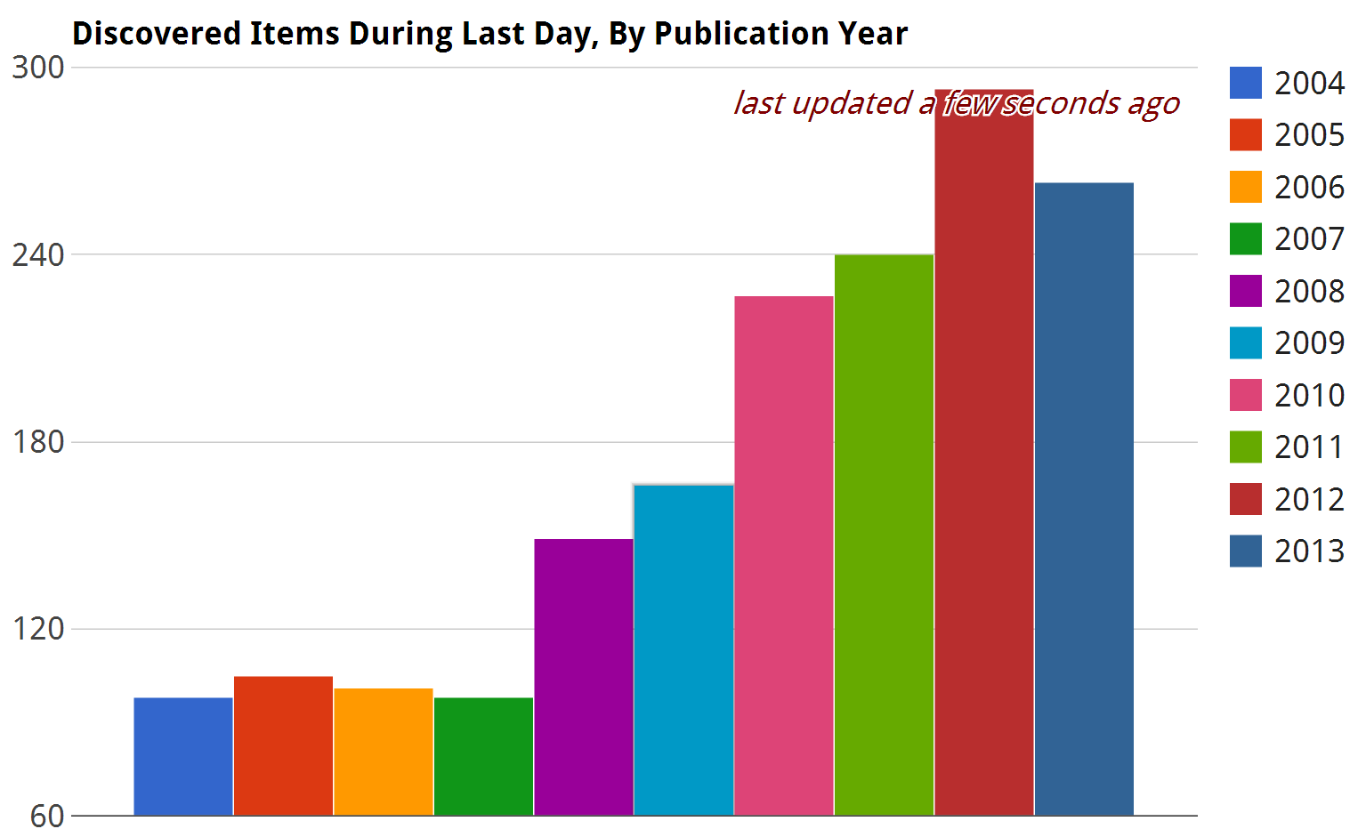
Generated using Google Charts [Link to live version]
Notes:
The previous data is what drives this Chart. (This is created using Google Charts, discussed later).

Slide 23
Example 3: Tabulating Title
{ timestamp: '2013-11-07T20:47:26-05:00',
Title:
[ [ 'special', 14 ],
[ 'olympics', 13 ],
[ 'fundraising', 10 ],
[ 'cannabis', 10 ],
[ 'food', 9 ],
[ 'united', 7 ],
[ 'history', 7 ],
[ 'intake', 6 ],
[ 'sweeteners', 6 ],
[ 'genetically', 6 ],
[ 'sex', 6 ],
[ 'energy', 6 ],
[ 'social', 6 ],
[ 'transsexuality', 6 ],
[ 'children', 6 ],
[ 'changed', 6 ],
[ 'modified', 6 ],
[ 'effects', 5 ],
[ 'states', 5 ],
[ 'discourse', 5 ],
[ 'meyerowitz', 5 ],
[ 'trafficking', 5 ],
[ 'north', 4 ],
[ 'mentoring', 4 ],
[ 'medical', 4 ],
[ 'narrative', 4 ],
[ 'cbd', 4 ],
[ 'joanne', 4 ],
[ 'journal', 4 ],
[ 'state', 4 ],
[ 'mexico', 4 ],
[ 'era', 3 ],
[ 'america', 3 ],
[ 'economic', 3 ],
[ 'education', 3 ],
[ 'artificial', 3 ],
[ 'peace', 3 ],
[ 'high', 3 ],
[ 'security', 3 ],
[ 'treatment', 3 ],
[ 'weight', 3 ],
[ 'bugs', 3 ],
[ 'stink', 3 ],
[ 'cancer', 3 ],
[ 'students', 3 ],
[ 'theory', 3 ],
…
}
Last 1 Hour
Single words
Lowercase
Notes:
This is from http://libx.lib.vt.edu/services/summonvis/k

Slide 24
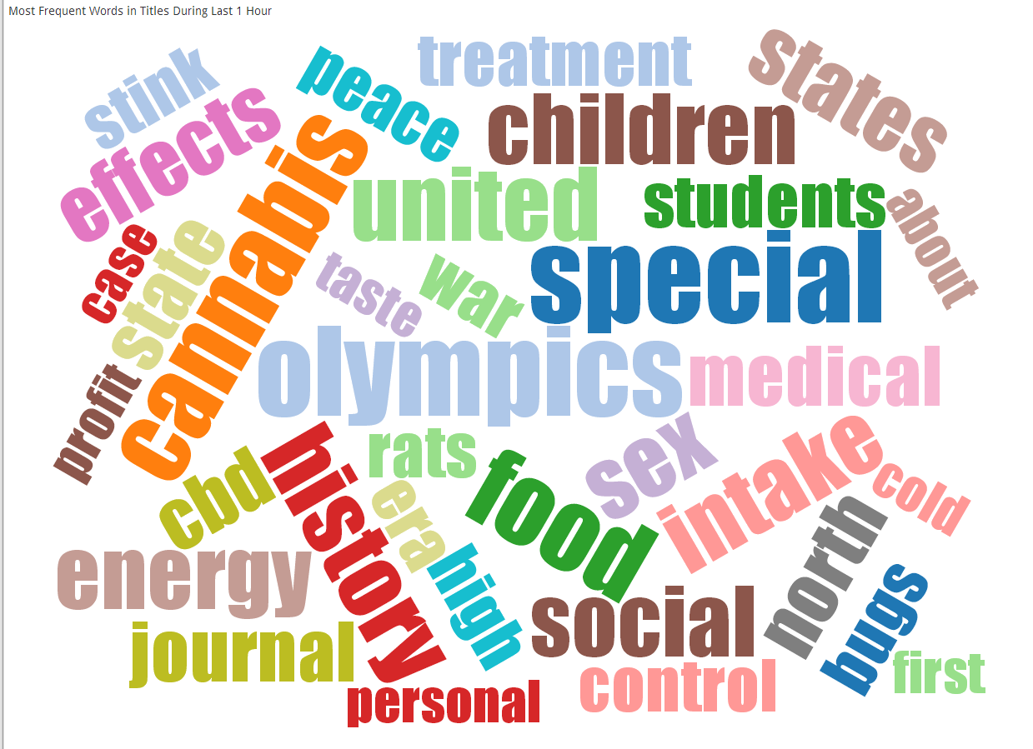
Notes:
This is a snapshot taken right when the previous one was current.

Slide 25

Visualization Implementation
<svg xmlns="http://www.w3.org/2000/svg" viewBox="0 0 512 512">
<title>HTML5 Logo</title>
<polygon fill="#E44D26" points="107.644,470.877 74.633,100.62 437.367,100.62 404.321,470.819 255.778,512 "/>
<polygon fill="#F16529" points="256,480.523 376.03,447.246 404.27,130.894 256,130.894 "/>
<polygon fill="#EBEBEB" points="256,268.217 195.91,268.217 191.76,221.716 256,221.716 256,176.305 255.843,176.305 142.132,176.305 143.219,188.488 154.38,313.627 256,313.627"/>
<polygon fill="#EBEBEB" points="256,386.153 255.801,386.206 205.227,372.55 201.994,336.333 177.419,336.333 156.409,336.333 162.771,407.634 255.791,433.457 256,433.399"/>
<path d="M108.382,0h23.077v22.8h21.11V0h23.078v69.044H152.57v-23.12h-21.11v23.12h-23.077V0z"/>
<path d="M205.994,22.896h-20.316V0h63.72v22.896h-20.325v46.148h-23.078V22.896z"/>
<path d="M259.511,0h24.063l14.802,24.26L313.163,0h24.072v69.044h-22.982V34.822l-15.877,24.549h-0.397l-15.888-24.549v34.222h-22.58V0z"/>
<path d="M348.72,0h23.084v46.222h32.453v22.822H348.72V0z"/>
<polygon fill="#FFFFFF" points="255.843,268.217 255.843,313.627 311.761,313.627 306.49,372.521 255.843,386.191 255.843,433.435 348.937,407.634 349.62,399.962 360.291,280.411 361.399,268.217 349.162,268.217"/>
<polygon fill="#FFFFFF" points="255.843,176.305 255.843,204.509 255.843,221.605 255.843,221.716 365.385,221.716 365.385,221.716 365.531,221.716 366.442,211.509 368.511,188.488 369.597,176.305"/>
<svg>
Source: http://jsfiddle.net/danielfilho/GdCcA/
Notes:
This is from http://jsfiddle.net/danielfilho/GdCcA/
You could show this fiddle to explain things. Make any change, then hit Run to demo it.
A JSFiddle is an online program where you can type JavaScript/HTML/CSS and test it interactively.
We use HTML5, because it embeds SVG (Scalable Vector Graphics).
Write an XML-Dialect, called SVG, to produce graphics that scales (displays well in different resolutions).
Like with HTML/JavaScript, you can write either markup or you can write JavaScript code to manipulate the DOM, create new nodes. For instance, if you changed the ‘fill’ attribute of the polygon above to a different color, a certain part of the HTML5 logo would change. You could pull us the jsfiddle and change the first polygon to fill="#0000FF“ – where it now says E44D26 and then hit ‘Run’

Slide 26
Plotting Charts with Google Charts
Developed & Hosted by Google
Closed-source, but free to use
Uses SVG
Very customizable
Supports animations
Example: https://developers.google.com/chart/interactive/docs/gallery/columnchart#Example
Alternatives: flot, jqplot, HighCharts, etc. etc.
Notes:
We looked at a number of libraries, ultimately decided on Google because it appeared the easiest to use and adapt.
Others aren’t free (HighCharts) or have restricted licenses. But we’re not religious about it.
Animation is nice because the charts transitions from one set of bars to another in a easing transition.
Could click on example, it shows a description and (roughly) what the JavaScript code to use it looks like.

Slide 27
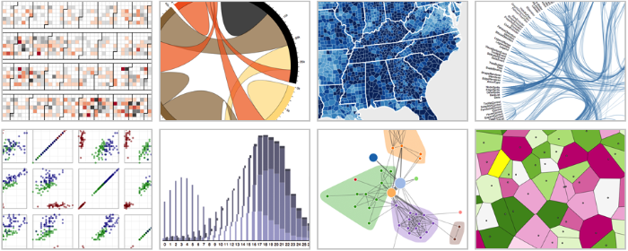
d3.js
Source: http://d3js.org/
D3: Data-Driven Documents Michael Bostock, Vadim Ogievetsky, Jeffrey Heer IEEE Trans. Visualization & Comp. Graphics (Proc. InfoVis), 2011
Notes:
Mike Bostock works for New York Times and does all their visualizations.
Jeff Heer is professor at Stanford (previously Berkeley). He is the driving force behind a number of visualization systems (prefuse http://prefuse.org/, flare : http://flare.prefuse.org/ which we’ve used for our 2008 SoftVis paper). Prefuse was Java-based, Flare was Flash-based, D3.js is JavaScript based.
D3.js is the state of the art.

Slide 28
d3.js - Description
D3 allows you to bind arbitrary data to a Document Object Model (DOM), and then apply data-driven transformations to the document. For example, you can use D3 to generate an HTML table from an array of numbers. Or, use the same data to create an interactive SVG bar chart with smooth transitions and interaction.
D3 is not a monolithic framework that seeks to provide every conceivable feature. Instead, D3 solves the crux of the problem: efficient manipulation of documents based on data. This avoids proprietary representation and affords extraordinary flexibility, exposing the full capabilities of web standards such as CSS3, HTML5 and SVG. With minimal overhead, D3 is extremely fast, supporting large datasets and dynamic behaviors for interaction and animation. D3’s functional style allows code reuse through a diverse collection of components and plugins.
Source: http://d3js.org/
Conceptually simple – separata data (model) from visualization

Slide 29
Using d3.js
Though well-designed, has a steep learning curve
Follows jQuery in style – provides operations on selections (e.g. everything can operate on multiple elements at once)
Supports transitions
E.g., change this circle’s size + position from 100 at (0, 0) to 150 at (45, 70) and make it move from the old to the new position in 1,000 ms.
Requires OO JavaScript skills
Fortunately: many components out there, many examples, very active user community.
E.g. WordCloud by Jason Davies [Click for demo]
Notes:
The slide says it all. I found in particular hard to learn the transitions, as well as how to handle adding/removing nodes.

Slide 30
Server Side Technologies Used
As data changes, need to update client display
Implemented in CoffeeScript using node.js [Link]
Node.js: JavaScript platform for running server-side code
Based on Google’s V8 JavaScript VM (same as used in Chrome browser)
CoffeeScript: is a language that compiles to JavaScript, but uses a cleaner and richer syntax [Link]
Socket.IO [Link]: is a library that supports client/server communication
Includes support for websockets
Kind of a successor to AJAX, makes “pushes” from server to client easier
Code is here
Notes:
Here’s a link to source code: http://libx.lib.vt.edu/services/summonvis/src/server/summonstats.coffee
We could really have used any language to implement the server side, but decided on node.js to use SocketIO – that is really nice because it’s then JavaScript on both sides, client & server, and we can use so-called websocket (a successor technology to AJAX: http://en.wikipedia.org/wiki/WebSocket)
All transferred data is JSON.

Slide 31
Introducing LibFX
Right now, a bunch of scripts JavaScript, Python, CoffeeScript
Source code of course available
Contributions/collaborations are invited
Idea: Build a cloud platform that allows other libraries to adopt and extend it
Particularly for non-programmers/non-sys admins
Not reliant on cloud, but ready to run “in the cloud” – on a IaaS or PaaS platform
LibX Edition Builder experience: adoption really took off once we created a management interface that allowed independent setup & exploration

Slide 32
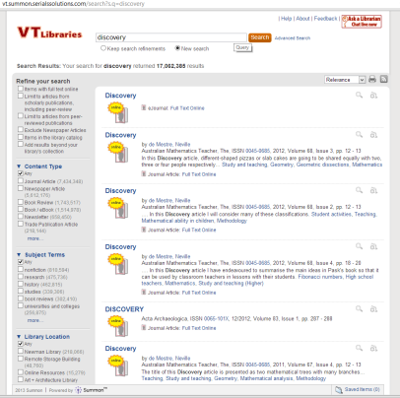
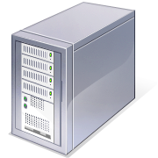








Commercial or open source discovery system, e.g. Summon, EBSCO, Blacklight
Users
Public Display &
Interaction
Web-Based
Control & Configuration
Interface
libFX
Real-time Data Collection
Data Visualization
Data Processing
& Storage
Offline
Analysis
Augmentation
Connector
Web-based visualizations,
Incl. social media
Internal Services, e.g. Circulation
Statistics, COUNTER Reports
External Services, e.g. Mendeley API, WorldCat Identities, CiteULike, altmetrics.com

Slide 33
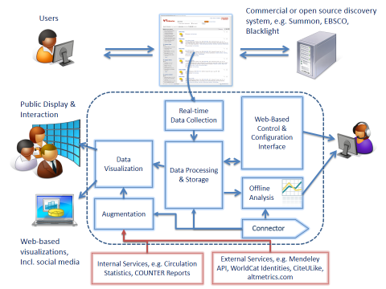
MapReduce-style
Aggregration
Aggregrated
Usage Data
Federation of libraries employing libFX

Slide 34
Challenges & Opportunities
What other information can be visualized?
Search terms? Search successes?
How to create an attention-catching, yet unattended visualization
Digital Signage
How to make the visualization interactive, allowing users to participate
E.g. QR codes, user feedback
Last demo: [Listen To Summon]
Website:
http://libfx.lib.vt.edu
Credits
Jason Davies for d3 wordcloud
Bojan Đuričić for justGage
Stephen LaPorte and Mahmoud Hashemi for Listen To Wikipedia
Based on Maximillian Laumeister Listen To BitCoin
The Art Of Web.com for 3D Cube example
Notes:
Not sure what to write here.

Slide 35
